Slide 1
27장 (2) Spark 2 - RDD
2019. 1학기
Jeong Joon Lee

Slide 2
RDD개요
RDD: Resilient Distributed Dataset
an immutable distributed collection of objects sets
Each RDD is split into multiple partitions (similar pattern with smaller sets), which may be computed on different nodes of the cluster.

Slide 3
1. Create RDD
2 ways to create RDDs
(parallelizing) by distributing a set of collection of objects
by loading an external dataset
(1) Creating RDDs By using parallelize( ) fucntion,
(참고)
parallelize(c, numSlices=None)
기능: Distribute a local Python collection to form an RDD.
Parameters
C : Interables
numSlices : 분할할 갯수

Slide 4
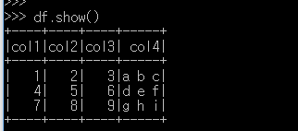


(Exam1)make RDD and then transform to DF.
(Exam2)make RDD
<At PySpark: pyspark –master local[2]>
“”” PySpark spark session을 기본 제공, 세션생성 생략가능
from pyspark.sql import SparkSession
spark = SparkSession \
.builder \
.appName("Python Spark create RDD example") \
.config("spark.some.config.option", "some-value") \
.getOrCreate()
“””
df = spark.sparkContext.parallelize([(1, 2, 3, 'a b c'),
(4, 5, 6, 'd e f'),
(7, 8, 9, 'g h i')]).toDF(['col1', 'col2', 'col3','col4'])
df.show()
myData = spark.sparkContext.parallelize([(1,2), (3,4), (5,6), (7,8), (9,10)])
myData.collect()

Slide 5
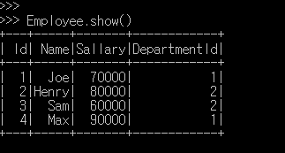
(2) By using createDataFrame( ) function
Employee = spark.createDataFrame([
('1', 'Joe', '70000', '1'),
('2', 'Henry', '80000', '2'),
('3', 'Sam', '60000', '2'),
('4', 'Max', '90000', '1')],
['Id', 'Name', 'Sallary','DepartmentId']
)
Employee.show()

Slide 6
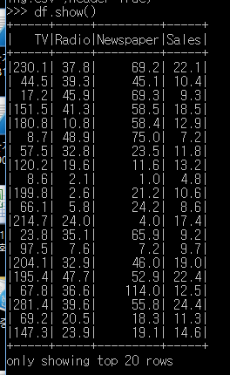
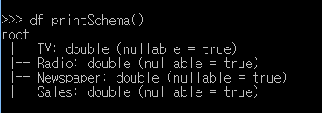
(3) By using read and load functions
(a) From .csv
참고
SparkSession.read: Returns a DataFrameReader that can be used to read data in as a DataFrame.
df = spark.read.format('com.databricks.spark.csv').\
options(header='true', \
inferschema='true').
load("C:/temp/Advertising.csv",header=True)
# 위의 패스를 변경하여 실행해야 함.
df.show(5)
df.printSchema()

Slide 7
(b) From database (skip)
(c) From HDFS (skip)
## User information
user = 'your_username'
pw = 'your_password'
## Database information
table_name = 'table_name'
url = 'jdbc:postgresql://##.###.###.##:5432/dataset?user='+user+'&
˓→password='+pw
properties ={'driver': 'org.postgresql.Driver', 'password': pw,'user
˓→': user}
df = spark.read.jdbc(url=url, table=table_name,
˓→properties=properties)
from pyspark.conf import SparkConf
from pyspark.context import SparkContext
from pyspark.sql import HiveContext
sc= SparkContext('local','example')
hc = HiveContext(sc)
tf1 = sc.textFile("hdfs://cdhstltest/user/data/demo.CSV")
print(tf1.first())
hc.sql("use intg_cme_w")
spf = hc.sql("SELECT * FROM spf LIMIT 100")
print(spf.show(5))

Slide 8

2. Spark Operations
Spark operations: Transformations and Actions

Slide 9
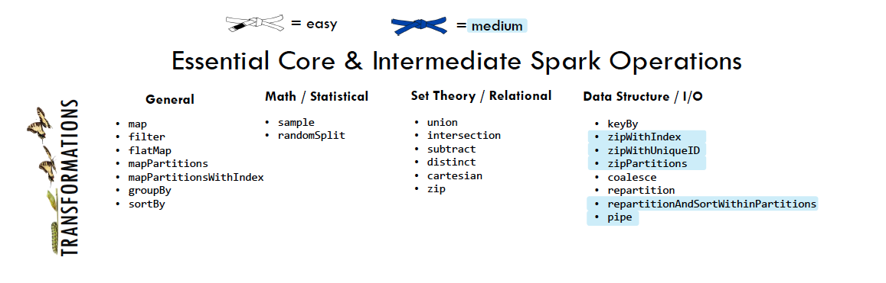
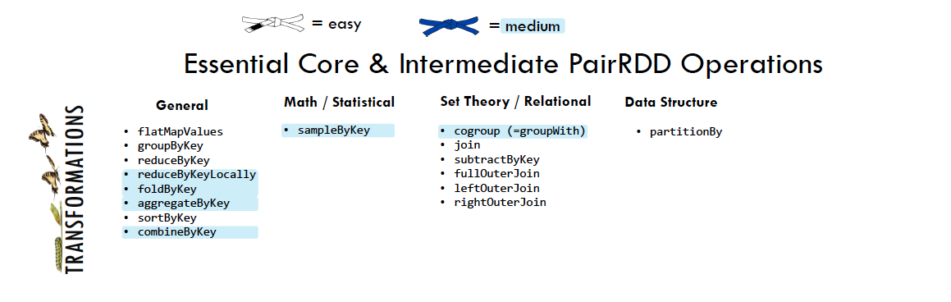
(1) Spark Transformations
Transformations construct a new RDD from a previous one.
(Examples) Filtering filtering data that matches a predicate.
Various Transformations

Slide 10
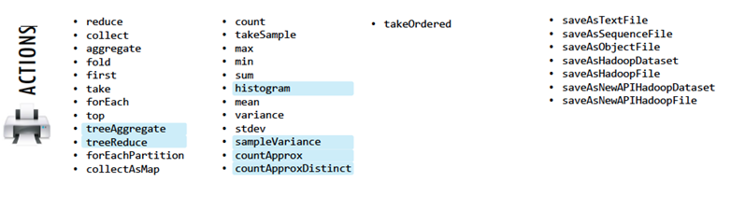
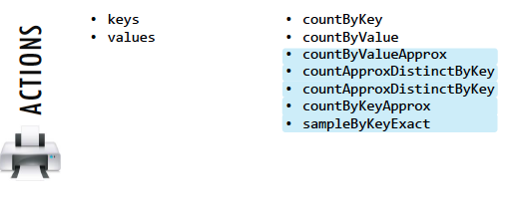
(2) Spark Actions
compute a result based on an RDD,
either return it to the driver program or save it to an external storage system (e.g., HDFS).

Slide 11



3. rdd.DataFrame vs. pd.DataFrame (self study)
Create DataFrame
From list
From Dict
Load DataFrames
From Database
From .csv
From .json
First n Rows
Column Names
Data Types
Fill Null
Replace Values
Rename Columns
Drop Columns
Filter
With New Column
Join
Concat Columns
Group by
Pivot
Window
rank
self study with leaning spark 5.3

Slide 12
Q&A

